Slide 1
It’s Game Time!
I-13 and I-16

Slide 2
Launch Calendar and Other Big Updates
Dates are to be determined – a new release date has not been announced yet.
Tentative Training Dates:
Monday, October 7 (will need to consider CTG)
Friday, October 11
Monday, October 14
Friday, October 18
Google Assistant will not be approved prior to launch. No ETA just yet. The text-based page set and Core First page sets will still include
The Mounting plate has been re-designed and will be for ConnectIt only. A Daessy adapter is needed for any Daessy mount and I-13/I-16. Stephen is updating the Daessy kits. Reminder – Small face base is needed due to the design.

Slide 3
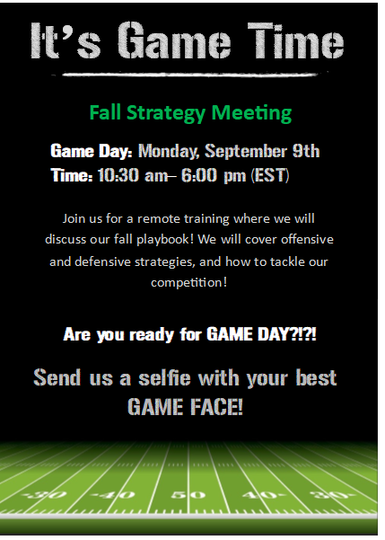
Save the Date

Slide 4
The Game Time Box

Slide 5



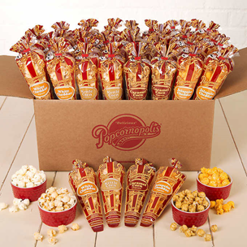
The Game Time Strategy Box
I-13 in its box
Charger
Quick Start Guide (re-designed)
Safety and Compliance Guide
Snap and Communicator 5 training cards
Binder (Playbook)
Folder with territory info
Foam Finger – sponsored by Trials Dept
Popcorn – sponsored by Reimbursement
Tumbler -
Terrible Towel – sponsored by Technical Support
Stress Reliever Football – sponsored by CSS
Write-on Football field
Rain Jacket – sponsored by Tara
Marketing Collateral (a set of frequently used marketing materials)
Confetti

Slide 6
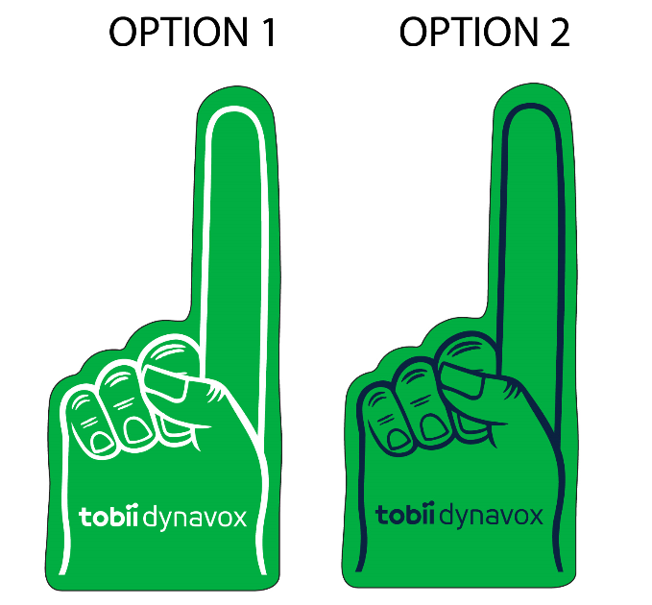

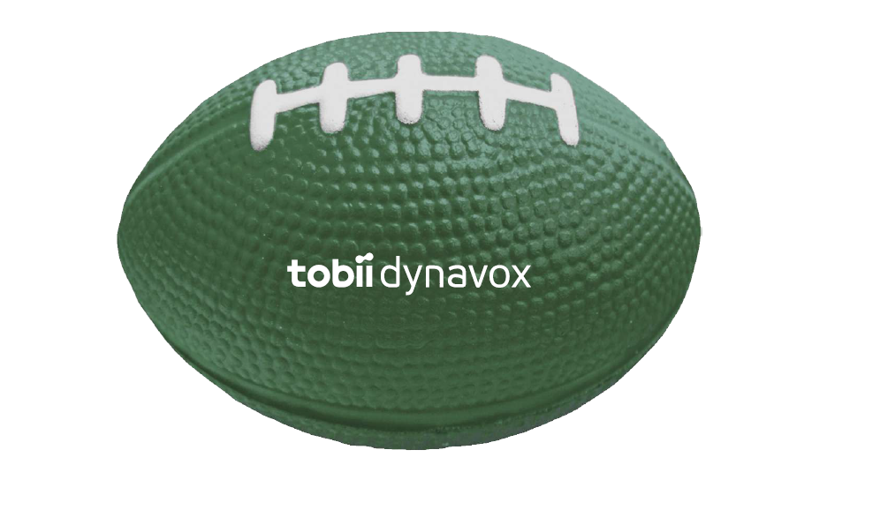
Status and Mock Ups
We are in the process of getting several quotes and mock-ups for the items in the Game Time boxes.
Item | Status
Binder | Quotes in process with printer; need to determine which binder style
Software/Hardware Guide | Quote in process with printer (spiral bound)
Foam Finger | 1 of 2 mock ups received, to be ordered
Write-on Football Field | 2 quote requests out with printers
Rally Towel | Quote in process with printer
Footballs | Mock ups in process
Tumbler | To be quoted
Popcorn | Will order closer to training
Jacket | Delivered
Confetti | Delivered

Slide 7
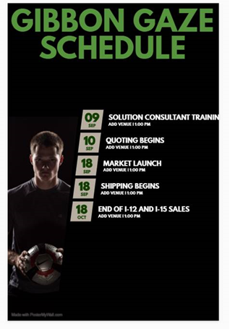
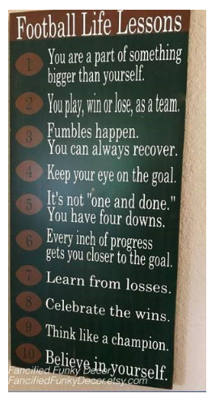
Calendar of Events
A schedule will be shipping with each Game Time Strategy shipment
Status: Quotes for printing have been requested
We’re taking Tara’s picture with a jersey and football when she is in the office next week.
Events for the schedule to include:
Shipping demo devices
Sales Training
Quote and Order Begin
Customer Shipping Begin
Trade In Promo Begin
Market Launch
Return/ Exchange End (30 days out)
End of Sale for I-12 and I-15
Planned Webinars
Trade-In Promo End

Slide 8
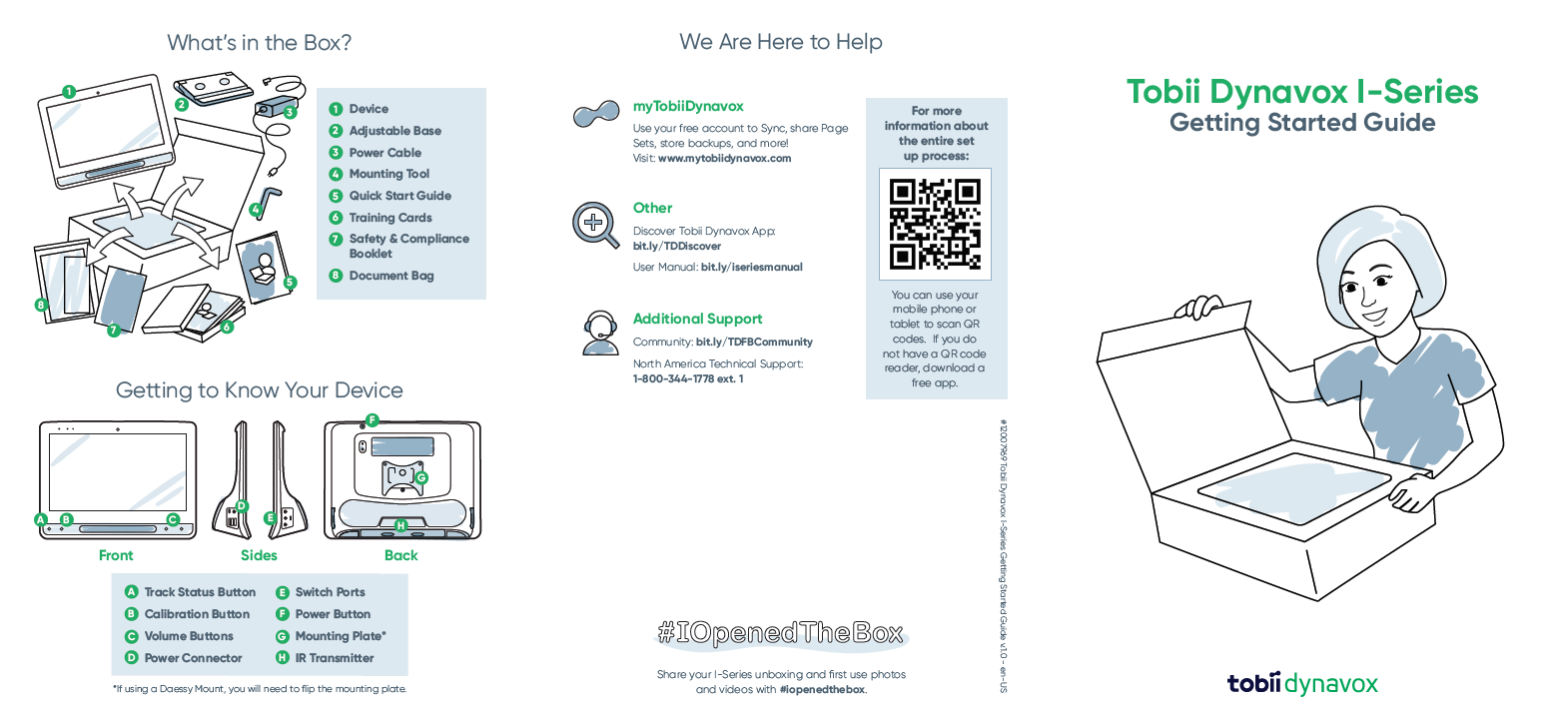
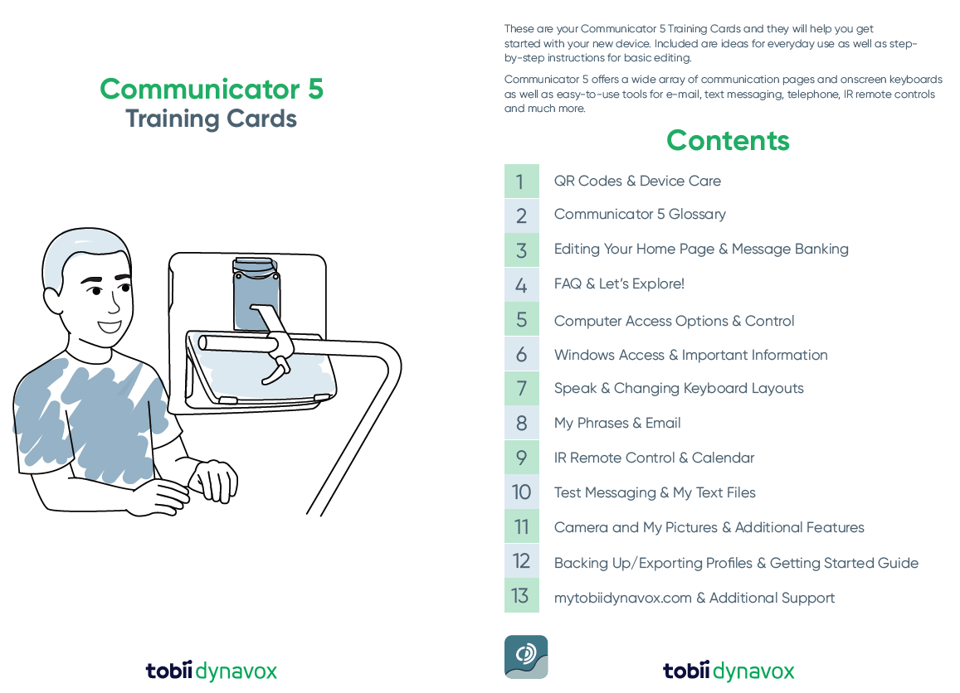
Quick Start Guide and Training Cards
Let’s review the Quick Start Guide and Training Cards:

Slide 9
Quick Start Guide and Training Cards
Notes about the Training Cards:
Current I Series users will be replacing the photos – Marketing is working on new photography
Communicator 5 (card 8) – we will add a statement about importing phrases, as the pre-programmed phrases are only visible outside of the US

Slide 10
Let’s Check out the Binder

Slide 11
The Binder – things to know
We’ll add QR codes throughout the binder to encourage Solutions Consultants to go to One Drive and other sites for updated information (QR codes will link to folders)
The binder contains information that is easily listed “At a Glance” like specifications and operational information such as discounts and part numbers. QR codes will go to more in-depth info where applicable (eye gaze comparison data)
The binder is still in draft form and items will be added/changed until we go to print.

Slide 12
Playbook (Binder)
Main Binder
I-13/I-16 Specification Chart (quick glance with I-12 comparison) | Regular Paper, Hole Punch
What’s in the Box and Included Software | Regular Paper – Hole Punch
Pricing and Sales Bundles | Regular Paper – Hole Punch
Eye Gaze Product / Competitor Comparison Guide (internal use) | Fold Out – Hole Punch
Keyguard and Accessory Listing w Part Numbers | Regular Paper – Hole Punch
Google Home Diagram (How it works info graphic and FAQs) | Regular Paper
Funding Addendum copy and Rationale Blurbs | Regular Paper, Hole Punched
Grid and Compass incompatibility list (what’s not working or recommended with Grid and Compass) | Regular Paper – Hole Punched
Microsoft Agreement Form | Regular Paper, Hole Punched
Microsoft Agreement Form – Q and A’s – Customer Facing Explanation | Regular Paper – Hole Punched
Discount Guide | Regular Paper – Hole Punched
Special Promos for Roll Out and Trade In instructions | Regular Paper – Hole Punched
Contractual Updates (VA, STAP, GATEDP Kaiser etc) | Regular Paper – Hole Punched
Return and Exchange Details | Regular Paper – Hole Punched
Trial Contract Updates (Picture of new trial form with link to folder) | Regular Paper – Hole Punch
Sales Contests | Regular Paper – Hole Punched
Webinar Schedule | Regular Paper – Hole Punched
Where to Find Resources – Links and QR codes for resources | Regular Paper – Hole Punched

Slide 13
Playbook (Binder)
In Binder Pocket
Eyegaze comparison sheet | Synthetic Paper, Folded
Software / Hardware Part Number Guide (double sided) | Synthetic Paper, Folded
Elevator Pitches | Postcard sized, synthetic paper
Trade In Flyer – One Pager (Customer Facing) | Regular Paper
Learning Catalog - External Version | Regular Paper?
Calendar of Events (Football schedule themed) | Glossy
In Folder – near Binder Territory Specific Information
I Series VIPs for Territory including info on pre-approved Product Placements | Landscape – regular Paper
Current Trial Listing with Statuses | Landscape – Regular Paper
Current Funding Case Listing | Landscape – Regular Paper

Slide 14
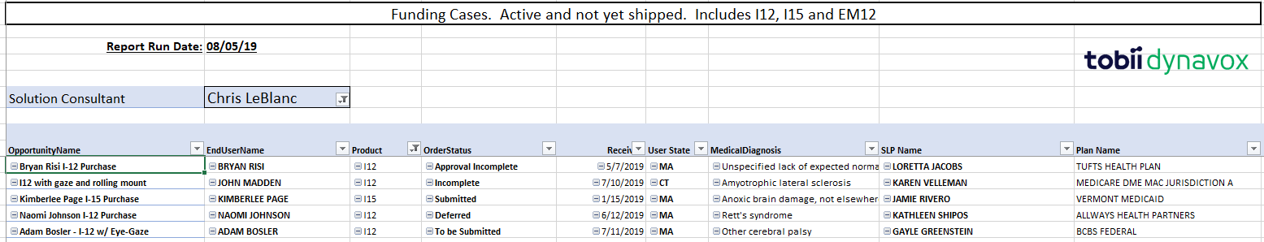
Territory-specific lists
Each US Solutions Consultant will receive a listing similar to this with the funding cases they have in process that are EM-12 or I Series. The SC’s should use this list to follow up with SLPs. The sample below is for Chris LeBlanc.
Listings of trial cases in process will also be included. Also to be included are the lists we shared with you with the VIP SLPs for I Series (SLPs receiving a PP device at launch will be noted.) If you haven’t already, please make sure you review those lists and send updates back to me.

Slide 15
Resource List

Slide 16
Resources in Development
What | Where it will be on Game Day | Who is responsible
Elevator Pitches | Binder, One Drive | Lucas, Lucinda
Unique Selling Points w Competitor view | Binder, One Drive | Lucas, Lucinda
Common Objections | Sales Training PPT Deck | Ben and Dani
Rear Window Video and Hands on Activity | Sales Training PPT Deck | Lucinda
Adaptive Buttons Video and Hands on Activity | Sales Training PPT Deck | Lucinda
Snap 1.9 Video (new features) | TBD – likely sales training | Lucinda
Revised Snap Product Information Sheet | Marketing site | Marketing
Computer Control Videos and Hands on Activities | Sales Training PPT Deck | Lucinda and Royden
Computer Control PI Sheet | Marketing site | Marketing
IS4 vs IS5 comparison (short version and long) | Binder, One Drive | Apryl and Harry
I Series Refresh Document | Marketing site | Marketing
Mirror for Android FAQ | Binder, One Drive | Lucinda and Kevin
Mirror for Android – How to enable your phone (customer facing) | Binder, One Drive | Lucinda
Mirror for Android – list of Phones | Binder, One Drive | John S and Moira

Slide 17
Resources in Development, cont.
What | Where it will be on Game Day | Who is responsible
Mirror for Android Video and PPT Slides (why we chose it, messaging, security) | Sales Training PPT Deck | Lucas
Beam and AccessIT Job Aid (w comparisons between the 3) | Binder | Lucinda (Kevin, with help from Betsy)
Software / Hardware Compatibility matrix | Part Number Guide and Binder (getting quote for a stand-alone resource) | Apryl, Sarah and Harry
Incompatible Features listing (Grid, Compass) | Binder | Anders, Lucas
What’s in the Box Overview | Binder | Apryl and Harry
Quick Start Guide and Trade Card Review | Sales Training PPT Deck | Stephanie
Unboxing Video | TBD | Stephanie
Build to Order Training Slides | Sales Training PPT Deck | Anders and Funding
Video of the non-BTO device set up | Do we need it? Same as now.
Microsoft Agreement Form | Funding Packets, e-funding site and Binder | Product Management
Microsoft Agreement - Customer Facing FAQ | Binder | Apryl and Marketing
Microsoft Agreement Training Slides | Sales Training PPT Deck | Anders and Funding
Sensory Eye Fx2 (at risk - may not make it in time) | Document or Sales Training PPT Deck | Anders and Lucas
Sensory Eye Fx2How to get Demo Codes and install | Binder or Sales Training PPT Deck | Apryl and Will

Slide 18
Resources in Development, cont.
What | Where it will be on Game Day | Who is responsible
Part Number Guide | One Drive | Harry
Quick Glance Page with common kits and Accessories | Binder | Apryl and Harry
Customer Facing Order Form | May not make it – will try | Apryl and Marketing
Trade-in Promo Flyer | Binder | Marketing
Process Outline for Trade in Promo | Binder, Sales Training PPT Deck | Apryl and Jeri
Discount Matrix | Binder | Apryl and Jeri
Funding Case Listing for each Solutions Consultant | Folder or Envelope near Binder | Cate and Funding
Sample Addendum | Binder and One Drive | Alicia T and Funding
Process Steps for Cases in Funding Pipeline | Sales Training PPT Deck | Cate and Funding
Returns and Exchange Process | Sales Training PPT Deck, Binder | Cate and L St Clair
Contractual Updates | Binder | Alicia and Jeri
Updated Trial Contracts (English and Spanish) | Website, One Drive, Funding Packets, Binder | Harry
Updated In the Box Trial Documentation | One Drive | Jeri and Marketing
Marketing Plan | Sales Training PPT Deck | Marketing

Slide 19
Resources in Development, cont.
What | Where it will be on Game Day | Who is responsible
Sales Contest Flyer | Binder | Jeri and Harry
Where to Find Resources (list of links and QR codes) | Binder | Sarah and Harry
Webinar Schedule | Binder | Sarah and Lucinda
External Version of Learning Catalog | Binder | Lucinda
Calendar of Events | Binder | Sarah and Brennah
Boardmaker Studio Updates | Sales Training PPT

Slide 20
Game Day

Slide 21
Game Day – Behind the Scenes Action
Apryl’s team will be updating/adding as many resources as possible on One Drive the day before training (Friday if the training is Monday). Cate is making a list of updates needed and we will be assigning team members to each.
Part number guide
Trial and loan contracts
Funding paperwork (Microsoft form)
Evaluation Center / LL Application brochure
We are pre-recording as much as possible to avoid Game Day issues.
PP team members will all be working behind the scenes answering chat, watching for raised hands, monitoring Bingo/Secret Message games and general production.

Slide 22
Sales Training – Morning Agenda
Time | Description | Presenter | Duration
10:30-10:35 | Intro to Zoom – how to use the tool, chat is monitored, raise hands with questions, mute when not speaking, etc. | Learning | 5m
10:35-10:45 | Introduce games (Bingo) – start first game | Cate & Team | 10m
10:45-11:10 | Intro – Why we are here, rules for the day, agenda, people randomly called on | Tara | 25m
11:10-11:50 | Reviewing device and new features Recording 1 and Hands on Activity Recording 2 and Hands on Activity Recording 3 and Hands on Activity | Anders, Lucas and Learning Team | 40m
11:50-11:55 | Winners of games announced, announce next game | Cate and Team | 5m
11:55-12:10 | Phone mirroring app / Beam | Anders | 15m
12:10-12:55 | Computer Control | Royden | 45m
12:55-1:25 | Break for Lunch |  | 30m

Slide 23
Sales Training – Afternoon Agenda
Time | Description | Presenter | Duration
1:25-1:30 | Winners of games, announce next game | Cate & Will | 5m
1:30-1:45 | Google Assistant | Dave | 15m
1:45-1:50 | Sensory Eye FX | Lucas | 5m
1:50-2 | Grid & Compass compatibility | Lucas, Anders | 10m
2-2:05 | Snap Updates | Lucas | 5m
2:05-2:35 | OOBE / User testing results | Stephanie | 30m
2:35-2:40 | winners of games, announce next game | Cate & Will | 5m
2:40-3:05 | Explain BTO | Jaime, Kelsey, Tammy, Anders | 25m
3:05-3:20 | Funding | Jaime, Kelsey, Tammy | 15m
3:20-3:30 | Returns & exchange details | Lindsay St. Clair | 10m
3:30-3:40 | Trade-in promo & discounts | Apryl | 10m
3:40-3:50 | List of spreadsheets – scavenger hunt | Apryl | 10m
3:50-4:15 | Afternoon break |  | 25m
4:15-4:20 | winners, final game | Cate & Team | 5m
4:20-4:45 | Marketing strategy & materials | Grace | 25m
4:45-4:55 | Learning plan and new content | Lucinda, Leigh | 10m
4:55-5:35 | Sales messaging | Ben & Dani | 40m
5:35-5:40 | Final game winner, Sales contests & closing | Tara | 5m
5:40-6 | Regional Team – Daily Wrap Up RDs to let team know where to join regional meeting following Tara’s closing remarks |  | 20m

Slide 24

Pump Up the Excitement
Game Time Fun!

Slide 25
Getting that Stadium Vibe
Jumbo-tron Games and Fun
Follow the Ballhtps://www.youtube.com/watch?v=Vh-FX0LoYbI
//www.youtube.com/watch?v=Vh-FX0LoYbItps://ww.youtube.com/watch?v=Vh-FX0LoYbI
TD Trivia
The Wave – office style
Coach / Player Profiles
Need help from RDs for this one
Rookie and IR(?) Lists
Music
Sweet Caroline
7 Nation Army
Renegade
We are the Champions (closing music)

Slide 26
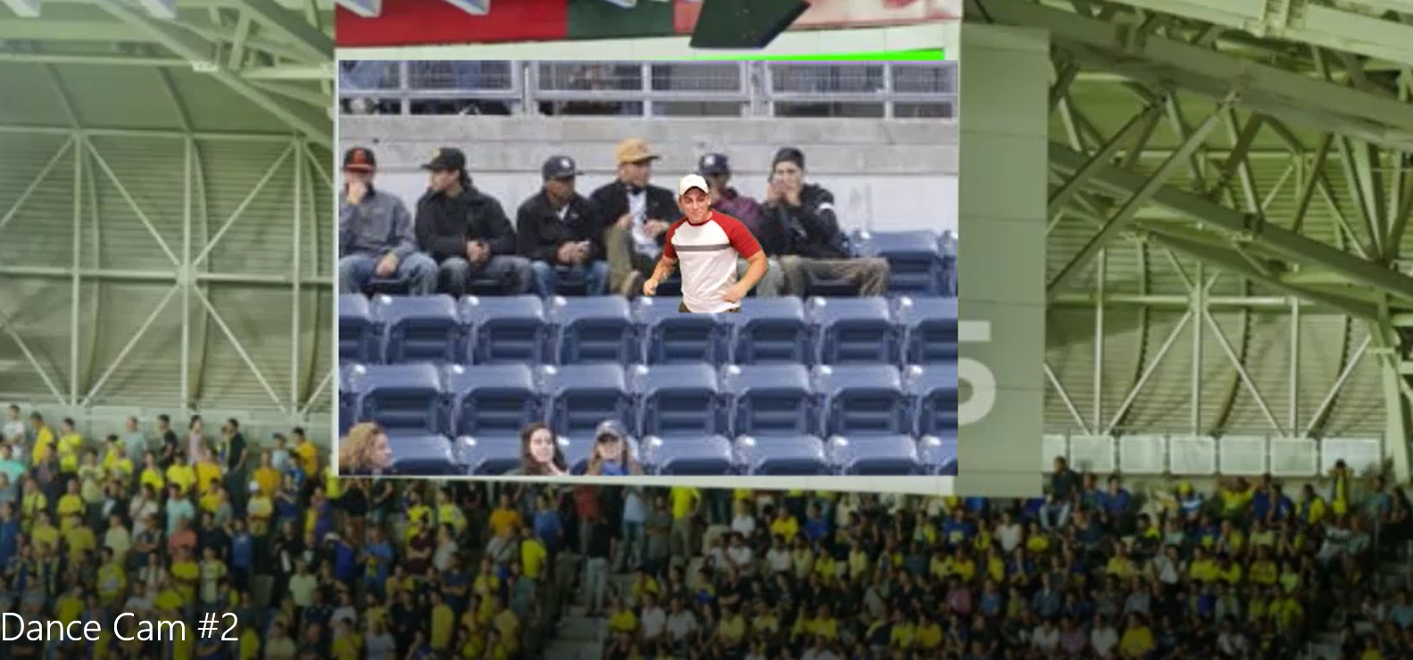
Dance Cam Try-Outs
Let’s watch the try out footage…
Music
Moves Like Jagger
Sweet Caroline
7 Nation Army
Renegade
We are the Champions (closing music)

Slide 27
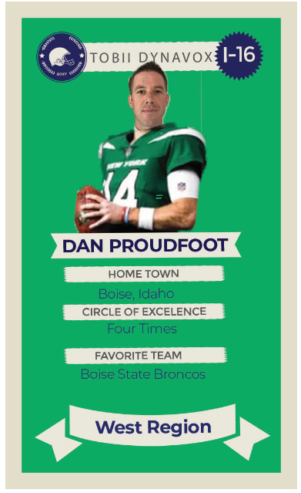
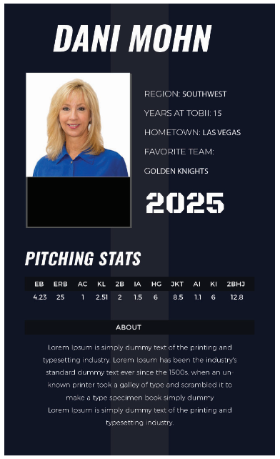
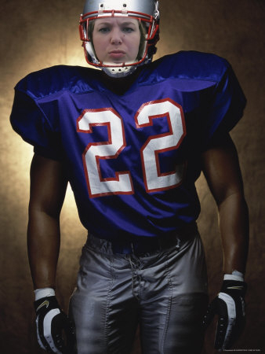
Player Cards – on the Jumbotron
We need your help with this one!
Help us define player stats
Let’s get some photos and see your dance moves

Slide 28
More Jumbotron Fun – Sample Trivia Questions
In North America, we sold more of this device than any other in 2019?
Josh Witt joined Dynavox in what year?
Which Solutions Consultant has sold the most PCEye products in 2019?
Molly Holmes is one of how many siblings?
Ali Demirel, our Director of Global Quality, speaks this many languages?
What was the first SGD produced by Tobii or Dynavox that featured Eye Gaze?
Tara Rudnicki’s favorite place to be is where?

Slide 29
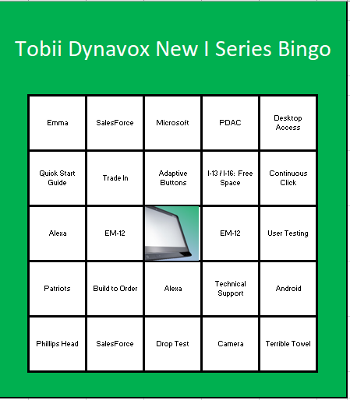
Games during Sessions
Pre-training games and prizes
Hidden in the binder - Chat us the part number for X when we give the prompt and win
Bingo
First half game
Pre-configured Bingo (Tobii) board will be in the binder (graphics not finalized)
Harry configured the boards to pull the squares randomly - we will try it out during the walk throughs
Tobii Secret Message
Second half game
We’ll hide a secret message in the Powerpoint Slides for the afternoon session.
Any suggestions for a message?
We will practice during training walk throughs

Slide 30
Practice Sessions
Currently, training meetings and practice sessions have been scheduled for:
Friday, August 9th kick-off
Tuesday August 13th – Resource Review
Monday, August 19th
Thursday, September 5th
Wednesday, September 18th – Production Practice
Lucinda’s team meets weekly to review progress on training videos and materials.

Slide 31
Sales Contests and Promos

Slide 32
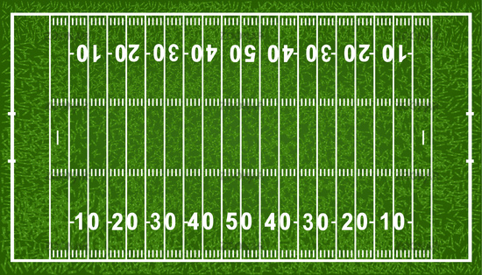
Sales Contest
Get 100 Yards and a Touchdown to WIN!
Earn yards through activities, participation in the sales training and bookings.
Grand Prizes: Tickets to a game of your choice up to $ x
2nd and Third Place Prizes: Omaha Steaks package (or Whole Foods GC for Vegan folks)

Slide 33
Touchdown to Prizes!
Yardage to be gained during meeting: (can gain up to 50 yards during training session)
10 yards for first 5 people to send email regarding tag on finger
10 yards for anyone emailing a part number for either the I-13 or I-16 during a specific time
10 yards for emailing trade in part number during a specific time
20 yards for first three people to win Bingo or the Secret Message (must be confirmed winner, possibility of 6 winners)
10 yards for first person to write wahoo in chat
10 yards for first three people to ask a question in chat
10 yards for first three people to verbally ask a question
Yardage to be gained following the meeting
20 yards for the first 3 people sending an Emma email to your SLPs and others (send Emma email to Jeri)
10 yards for first 10 people to have 5 activities to demonstrate the devices
10 yards for first 10 people to have 5 activity for evaluations with the device
10 yards for first 10 people to have 5 phone calls with SLPs regarding the device
10 yards for first 10 people setting up one trade in opp with an eval center/lending library (must include contract for center)
10 yards for first 10 people setting up one direct sale opp
10 yards for first 10 people setting up one funding opp with client information form attached.
10 yards for first three people to set up three direct sales opps
10 yards for first three people to set up three funding opps with client info form
Touchdown (must have 100 yards also)
First to get direct sales order (not an exchange – must be a new order)
First to get funding order (not an exchange – must be a new order)
Add Team Prize – Extra day PLT

Slide 34
Trade In Promo
To be Approved by Finance – Not Final
$2,000.00 Discount with trade in of two (2) devices (can be a competitor’s device) and purchase of an I 13 or I 16 with Gaze.
$1,500.00 Discount with trade in of one (1) device (can be a competitor’s device) and purchase of an I-13 or I-16 with Gaze
October 1st through December 15
Estimated gain in bookings: $700k+
The last I-Series promo (Q4 2016) resulted in $535k in bookings.
In-house team has met to review the process – it will be a little different than in previous years due to the IFRS changes (deferred revenue)
- Quotes produced by Solutions Consultants will be reviewed and updated daily by the CSS team to add the correct IFRS part numbers.

Slide 35
Discounts
Evaluation and Lending Library Discounts will remain as they are now as will single device and volume discounts.
An updated Evaluation Center / LL Application will be stored in One Drive
Product | Solutions Consultant | AAC Regional Director | Evaluation Center Discount
Single Device | 0% | 5% | 10-30% dependent on device
Volume 5-9 | 3% | 10%
Volume 10-19 | 5% | 12%
Volume 20+ | 7% | 15%

Slide 36
Game Prep: What You Can do to Help
Start thinking of Talking Points for you individual Team Meetings after the training
Send ideas for Secret Messages in the PPT slides
Send ideas for small prizes
Review the Resource List
Review the I Series VIP listing and finalize your region’s Product Placement SLPs
Lastly…
Dance and Pose for Pictures

Slide 37
Post Game Action

Slide 38
Activities Post Game
VIP SLPs who were pre-approved for Product Placements will either receive their devices and goodies or be sent a contract for completion.
Funding will begin to put cases in Equipment Verification status. (depending on what process is approved)
We will stop sending I-Series + devices for trial. Solutions Consultants will be contacted as cases hit Cate’s dashboard.
End of Sale of I-Series + devices is planned for @ 30 days post launch. The final date is to be determined. Devices in the funding pipeline will be honored.
In Q1 2020, we will ask for all old I-Series to be sent back. Solutions Consultants will be billed for devices not sent back.
Jeri will monitor yardage and touchdowns for the Sales Contests and we will ship prizes.

Slide 39
Questions?

